Slide 1
Ask2017 iOS iphone app entertainment/ free
When a puzzle is number-based, how does one get from a number or group of numbers to a word?

Slide 2
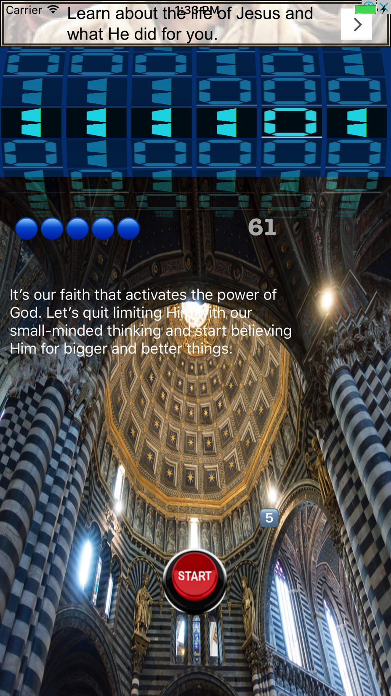
Hint

Slide 3
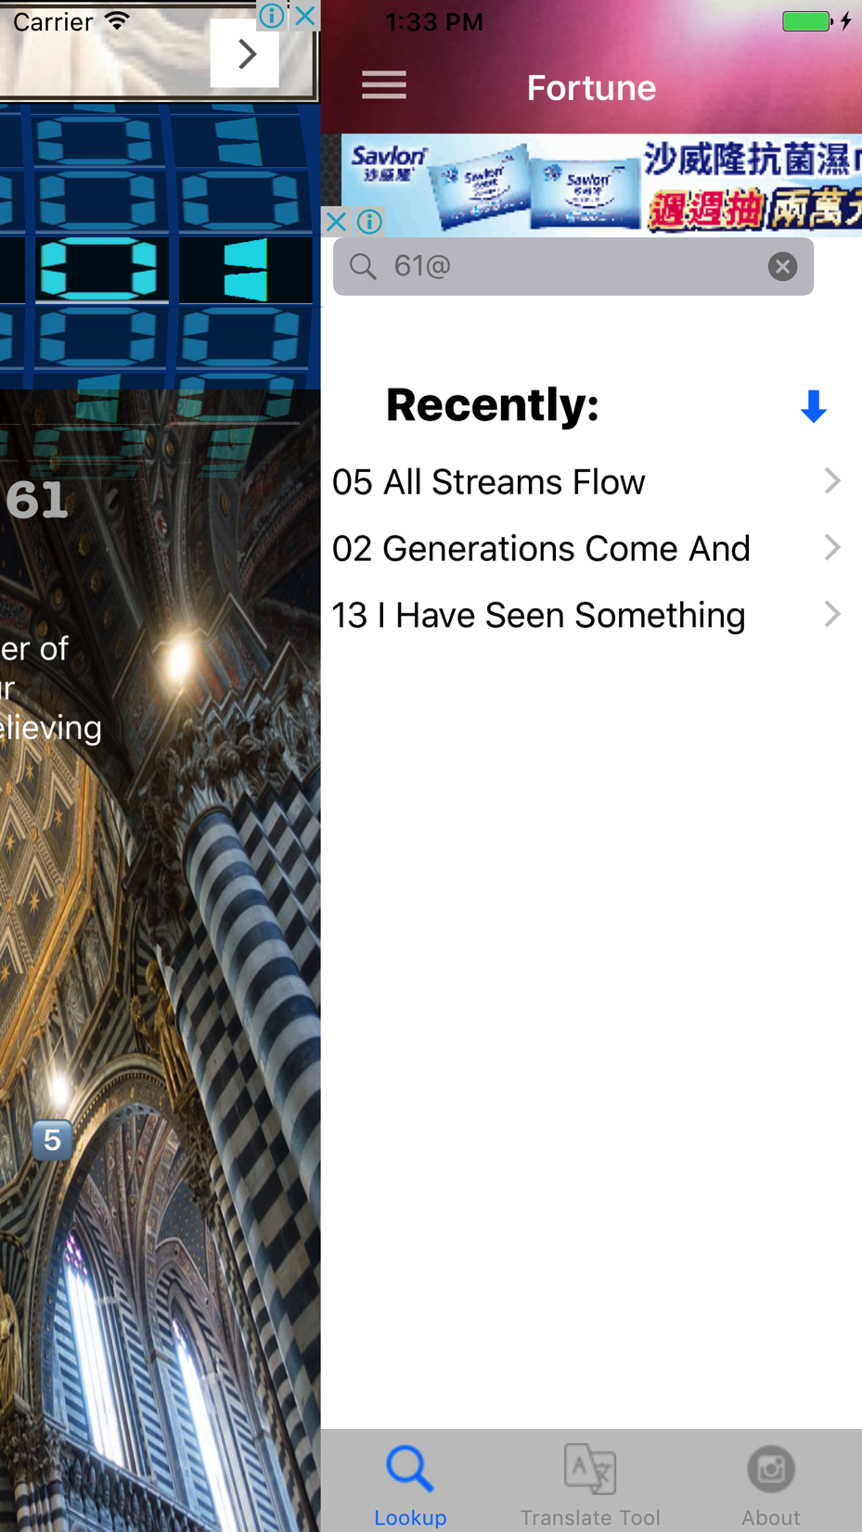
Through random word to measuring fortune, enhance self-confidence, act alert, and increase understanding of English words

Slide 4
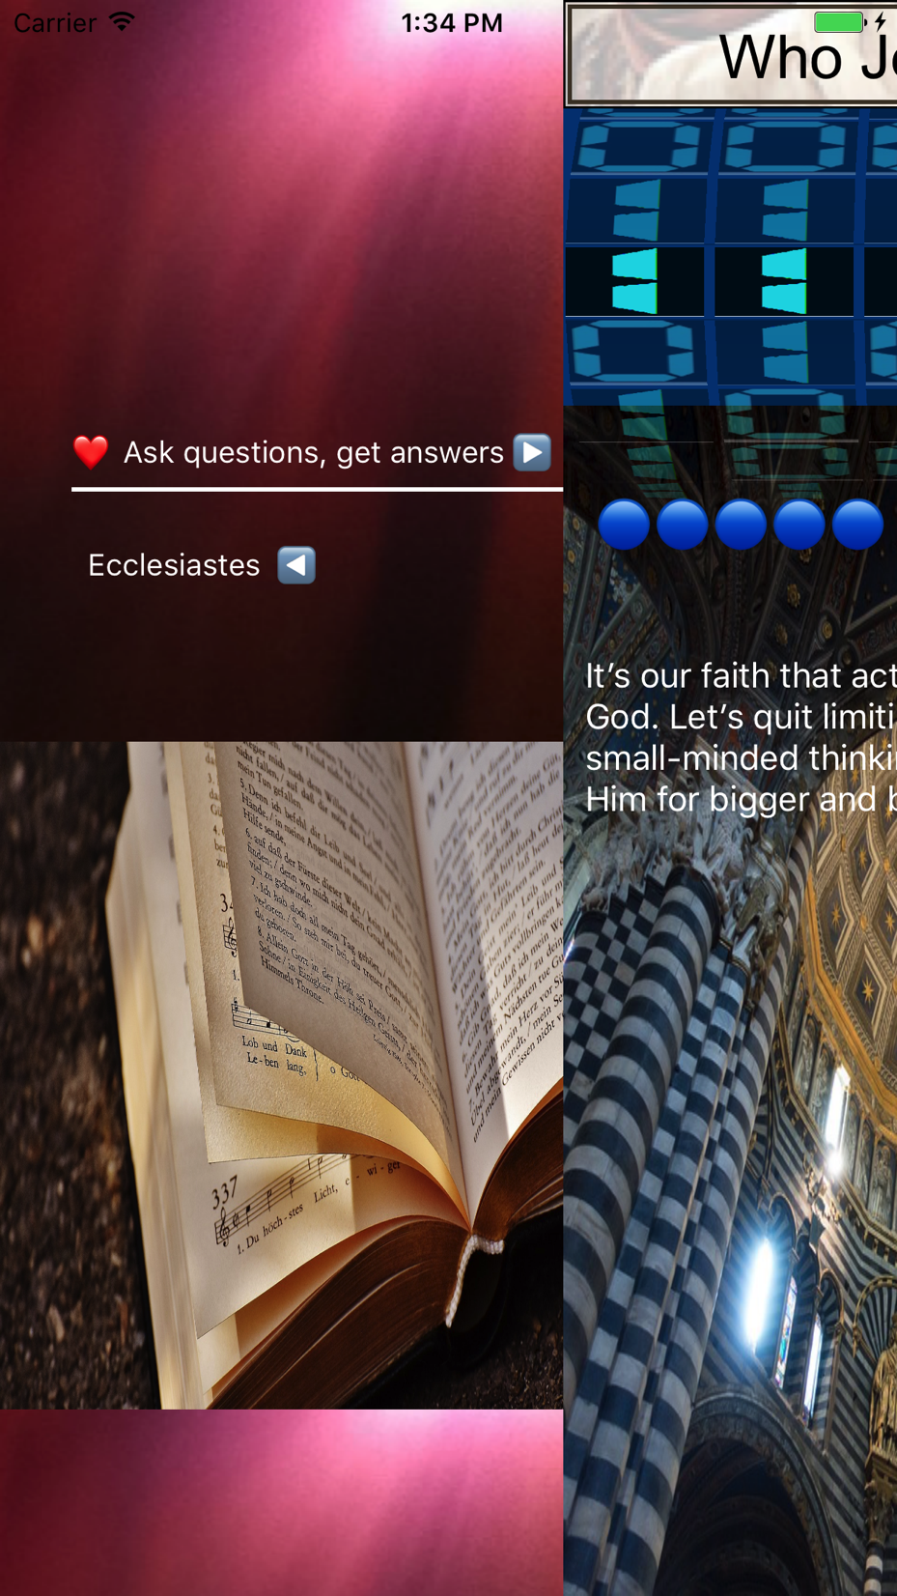
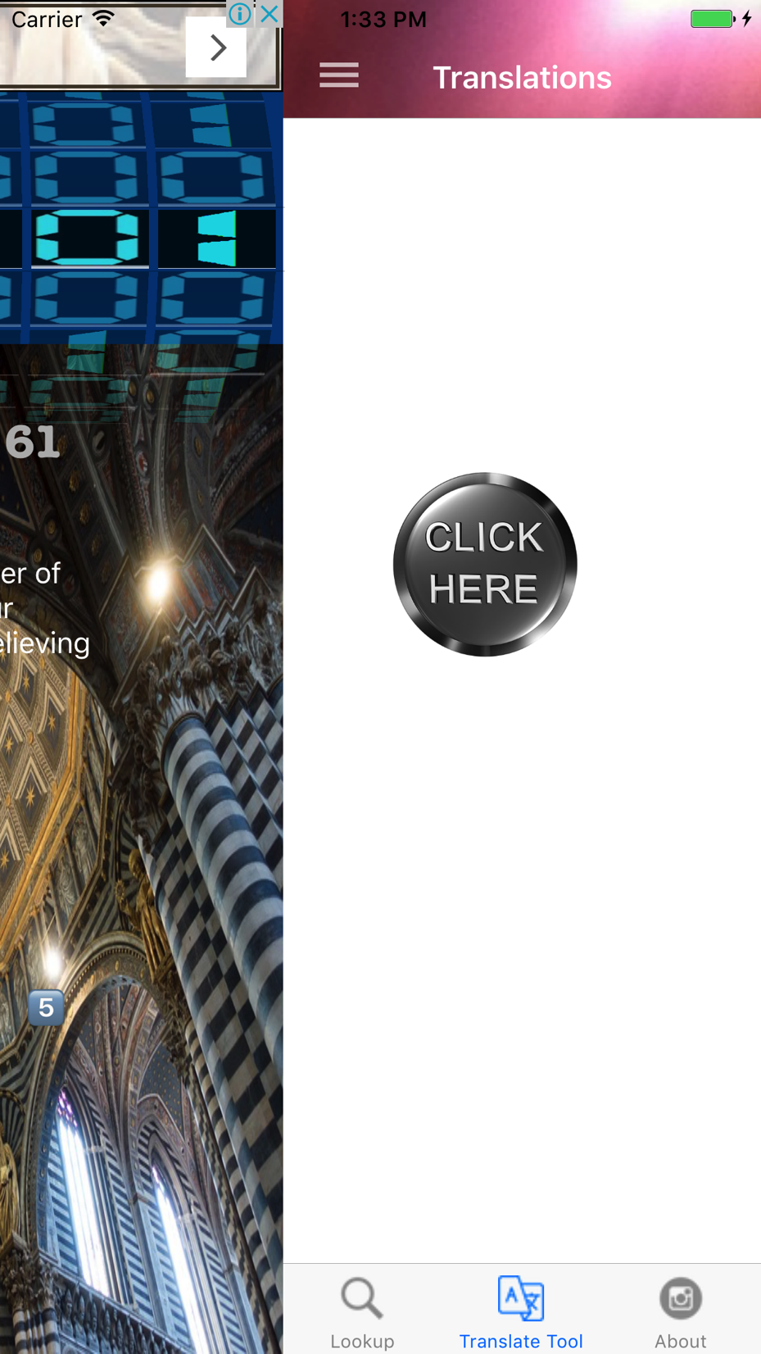
Clean and easy to use
Allow user to quickly swipe between sections

Slide 5
Look up word in just one tap
History tab lists words recently looked up

Slide 6
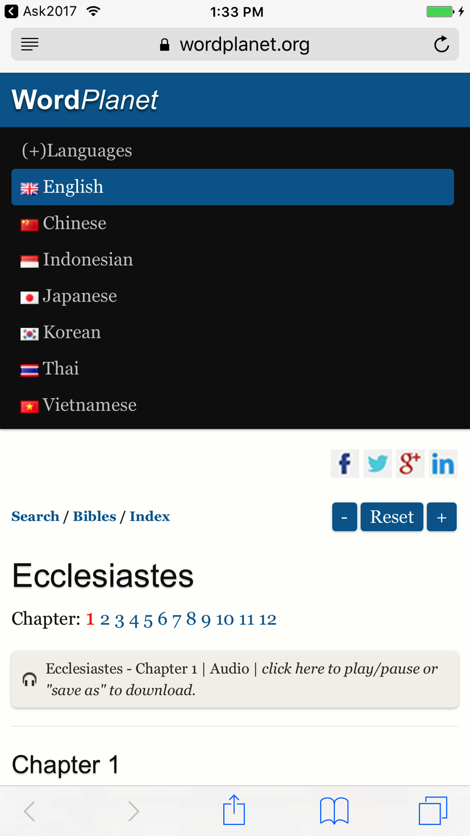
read hearing ads
Allow user to look up online

Slide 7
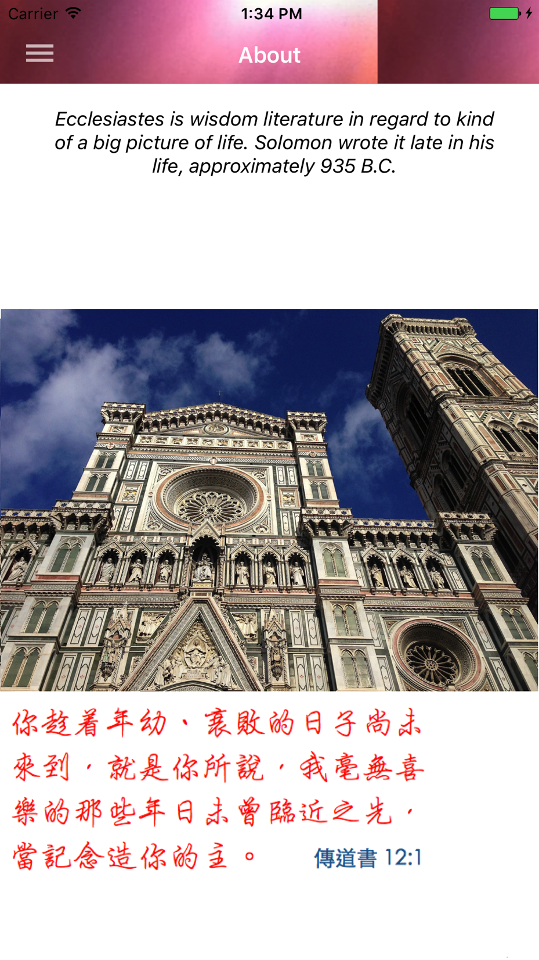
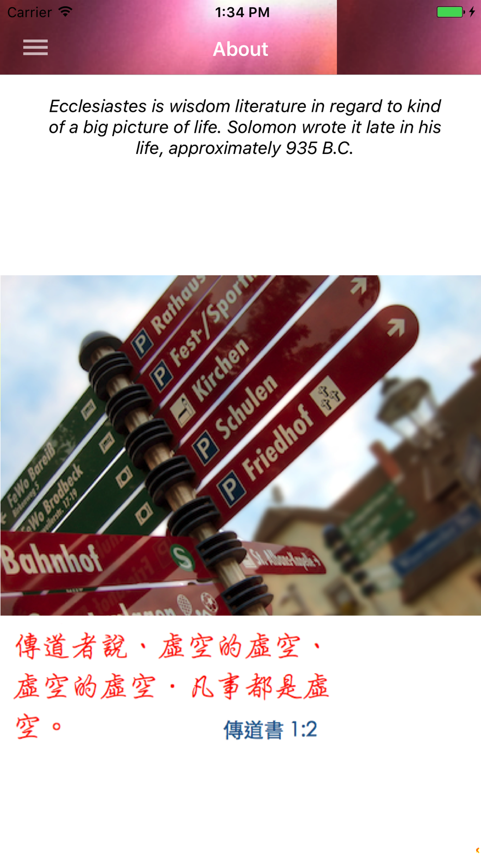
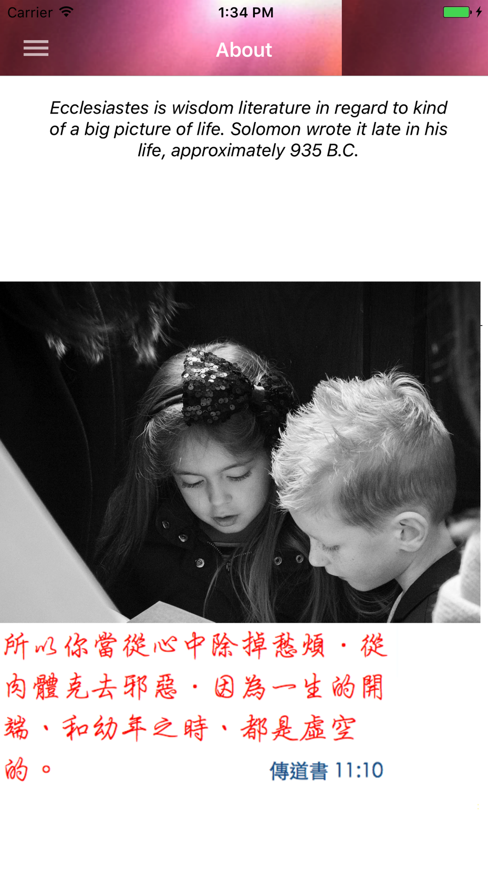
About ecclesiastes

Slide 8

Open iTunes and download
Ask2017 iOS iPhone
Free
Entertainment
https://itunes.apple.com/us/app/ask2017/

